Slide 1
The influence of a speed limit reduction on a traffic jam
Lecture with Computer Exercises:
Modeling and Simulating Social Systems with MATLAB

Slide 2
Contents

Slide 3
Contents
Introduction and motivations
Description of the model
Simulation results and discussion
Summary and outlook

Slide 4
Introduction and motivations

Slide 5
Introduction and motivations
Model:
Section of a busy two lane highway
Lane changing
Trucks and cars
Analysis of the influence of a speed limit reduction on the traffic flow in two cases

Slide 6
Introduction and motivations
Questions:
Case 1: No specific event causes the traffic jam
Studying the influence of the speed limit on self-induced traffic jams on a busy highway
Ideal speed limit?
Case 2: A specific event causes the traffic jam
Two events: sun blinding, accident
Is the traffic flow improved with a speed limit reduction?
Optimal starting point of the reduction? Ideal speed limit?

Slide 7
Introduction and motivations
Expectations:
Case 1:
We expect that the traffic flow is improved with a lower speed limit
Case 2:
We estimate a speed limit reduction has a positive effect on preventing or clearing a traffic jam

Slide 8
Description of the model

Slide 9
Basic program structure
Parameters, Variables & Vehicle Matrices
Time loop
Changing lanes
Update accelerations
Update velocities and positions
Add new vehicles to the lanes
Speed Limit
Disturbance
Saving

Slide 10
Description of the model
Changing lanes
For each lane separately
Marks cars which can change
Plenty of asymmetric conditions depending on the velocities and gaps of the other vehicles
Copy marked cars to the other vehicle matrix
Delete them from their old matrix

Slide 11
Description of the model
Update accelerations
Update accelerations with the “intelligent driver model”[1]
Accelerations depend on the velocity difference and on the desired distance to the vehicle ahead
Update every tenth time step
Inattentions, reaction time of the drivers

Slide 12
Description of the model
Update velocities and positions
Update velocities and positions with a simple Euler scheme
Time discretization: ∆t = 0.1s

Slide 13
Description of the model
Add new vehicles to the lanes
New vehicle if
distance to vehicle ahead is larger than the desired distance
time difference since the last car was inserted is greater than the “new car time”
Lane 1: only cars
Lane 2: 80% Cars, 20% Trucks

Slide 14
Description of the model
Speed Limit
Limits the desired velocity to the speed limit on a certain section of the highway during a desired time period

Slide 15
Description of the model
Disturbance
Induce the desired disturbance type
Sun blinding
Accident

Slide 16
Description of the model
Saving
Saves the data every second to the desired folder

Slide 17
Description of the model
Data processing functions:
“plot_graphics.m”
“plot_simulation.m”
Extended “draw_car.m”[2] to “draw_car_diff_colors.m”
“run_simulation.m”
“evaluate_simulation.m”

Slide 18
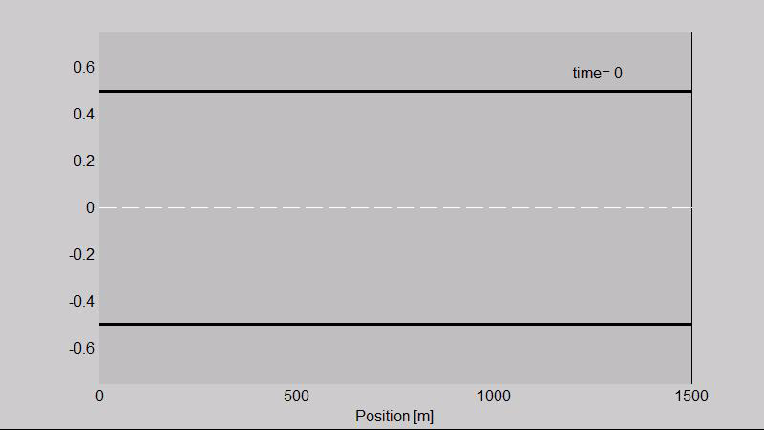
Visualization of the simulation

Slide 19
Simulation Results and Discussion

Slide 20
General Parameters and Settings
Two different cases:
Without disturbance
With disturbance
Two different disturbance types
Type sun blinding
Type accident

Slide 21
General Parameters and Settings
Simulation scale
Duration: 2000 seconds
Highway length: 10’000 meters
Speed limitation
100 km/h
80 km/h
Every case 20 times simulated

Slide 22
Without Disturbance
No self-induced traffic jam
Development of groups
Localized slowdown

Slide 23
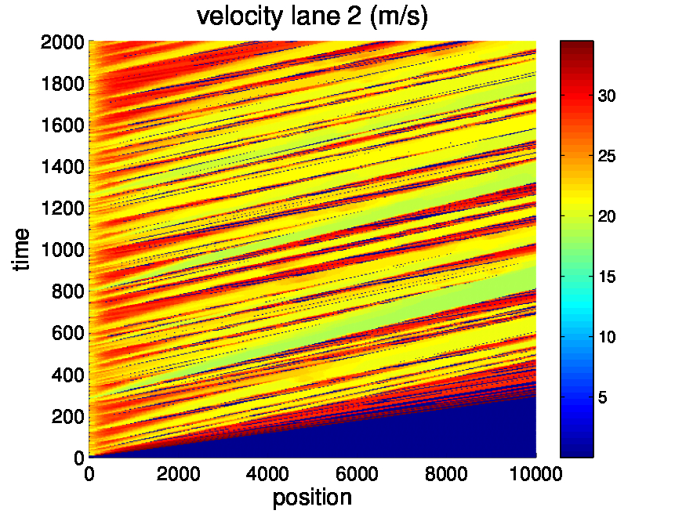
Without Disturbance

Slide 24
Disturbance type: sun blinding
Disturbance over longer period of space and time
Desired velocity is lowered (factor 0.6)
Sudden emergence can cause hard braking behavior

Slide 25
Without speed limit reduction
High vehicles/km density within disturbance zone
Traffic jam starts at the beginning of the disturbance zone
Jam propagates in the direction of highway origin with the time

Slide 26
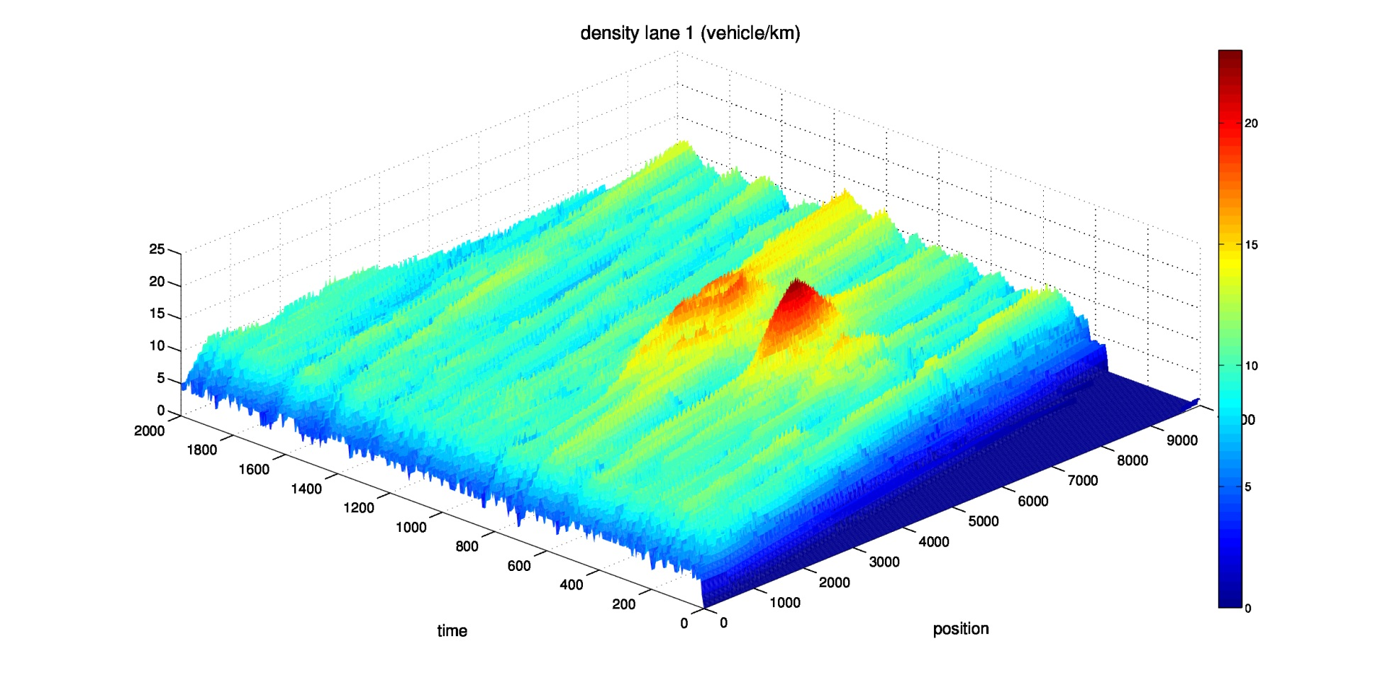
Without speed limit reduction

Slide 27
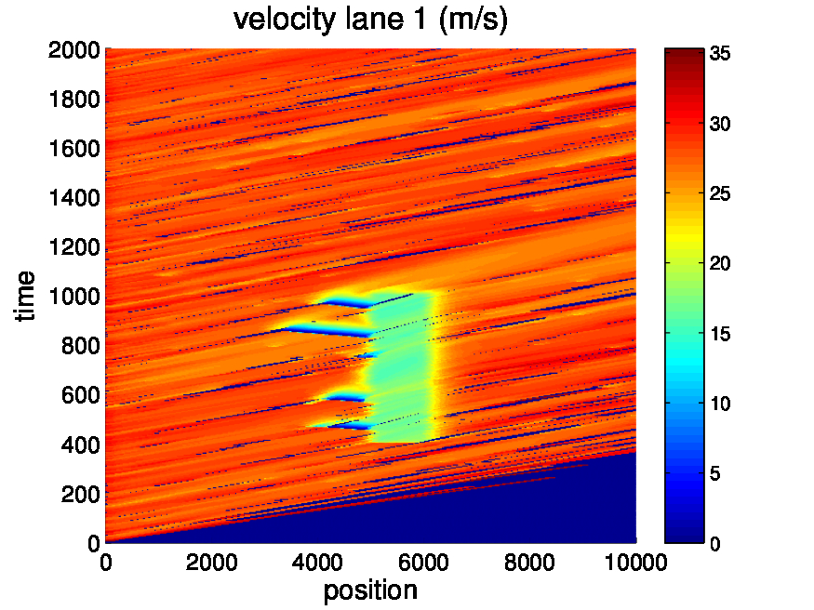
Without speed limit reduction

Slide 28
Speed limit reduction: 100 km/h
Speed limit reduction inserted before the disturbance happens
Similar density contribution
Less jam occurs

Slide 29
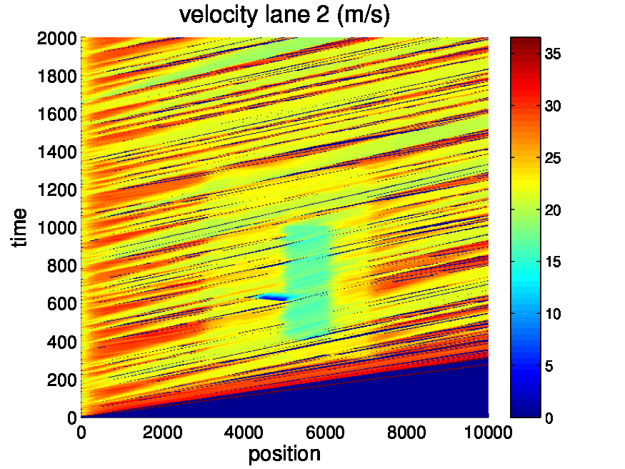
Speed limit reduction: 100 km/h

Slide 30
Speed limit reduction: 80 km/h
Region with traffic jam is replaced
No jam occurs in the disturbed zone anymore
Section with high vehicle density expands

Slide 31
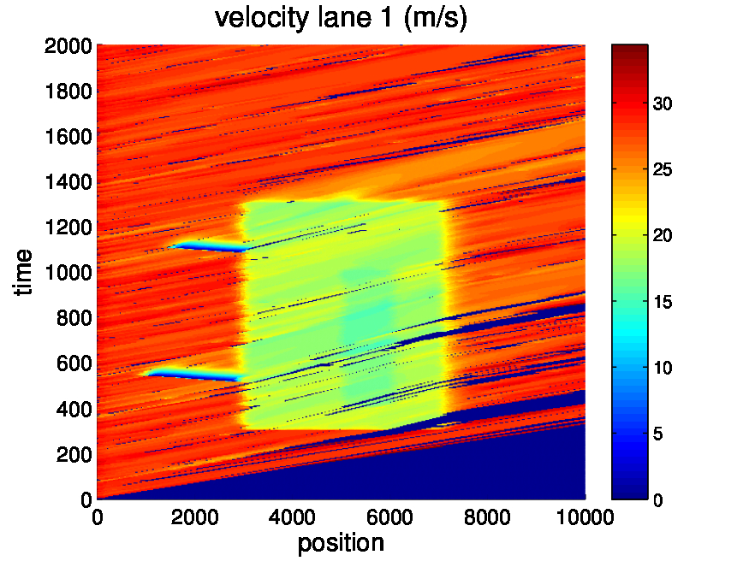
Speed limit reduction: 80 km/h

Slide 32
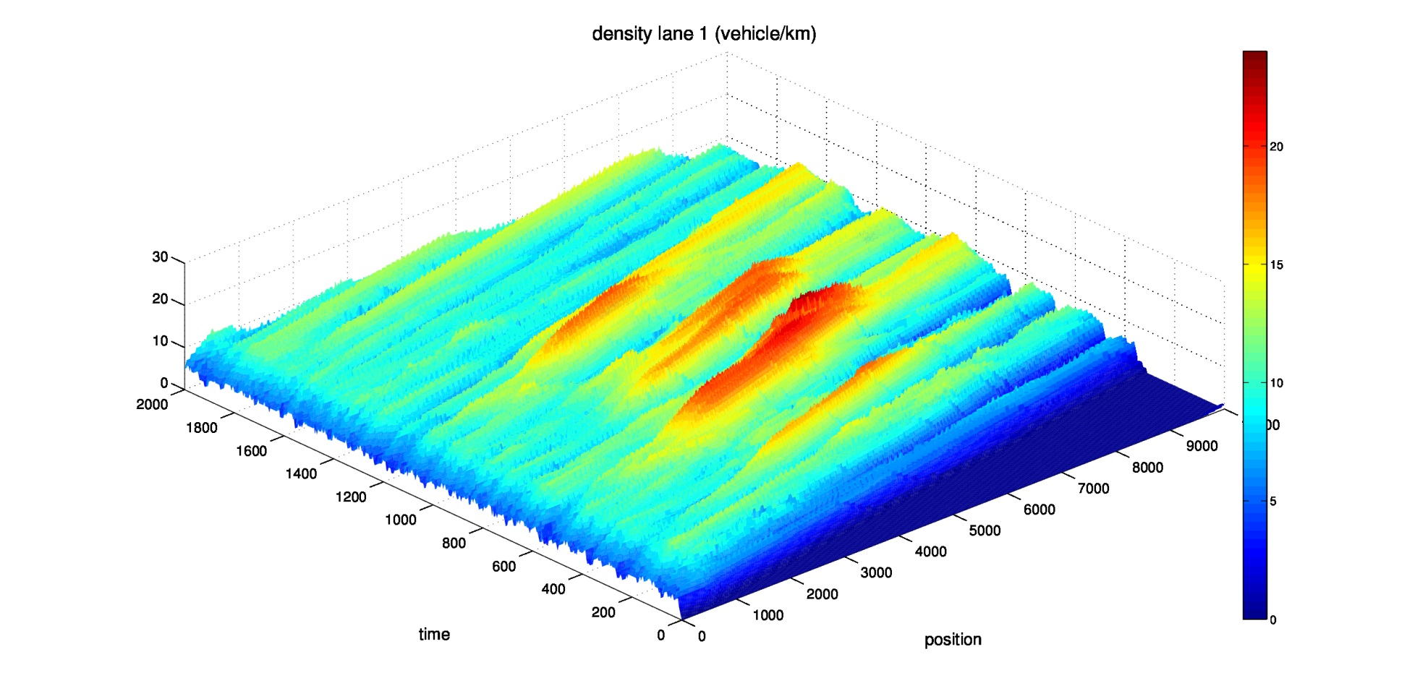
Speed limit reduction: 80 km/h

Slide 33
Disturbance type: accident
Disturbance localized in a small section
Desired velocity is approaching zero
Immediate and massive speed limit reduction leads to expanded jam development

Slide 34
Without speed limit reduction
Very high density within and ahead of the disturbed zone
Emergence of a second leg of jam

Slide 35
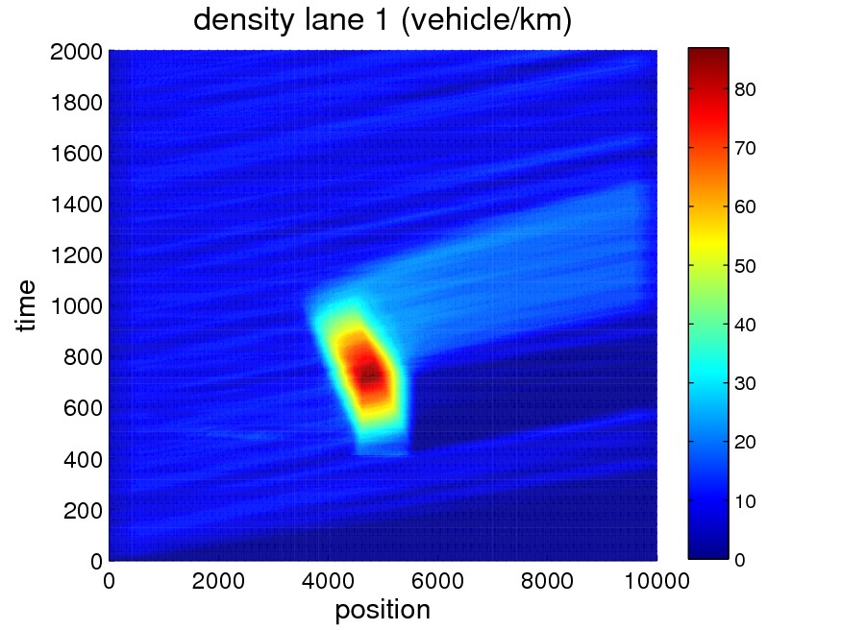
Without speed limit reduction

Slide 36
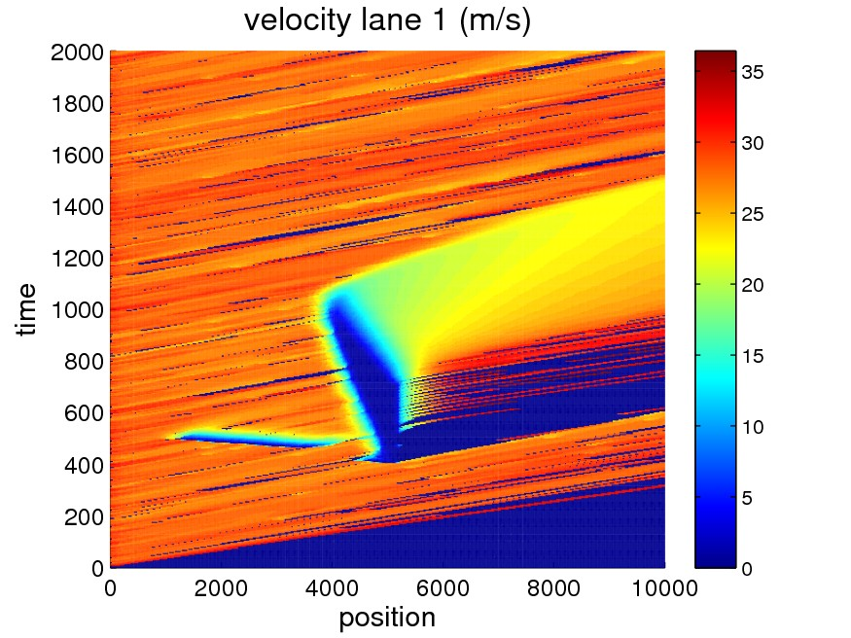
Without speed limit reduction

Slide 37
Speed limit reduction: 100 km/h
Speed limit reduction begins one minute after the accident
Similar behavior like without speed limit reduction, but second leg of jam solves faster

Slide 38
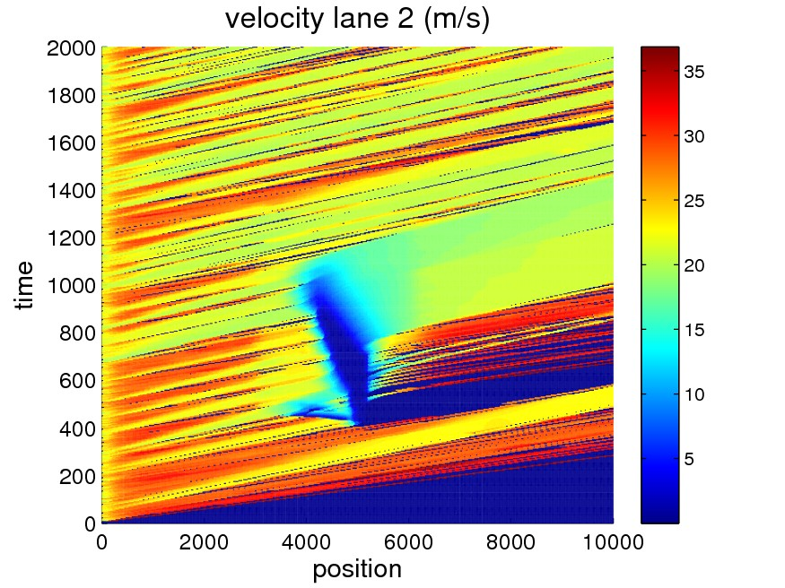
Speed limit reduction: 100 km/h

Slide 39
Speed limit reduction: 80 km/h
Region with high vehicle density hardly influenced
Main jam solves earlier
Additional jam develops where the speed limit reduction begins

Slide 40
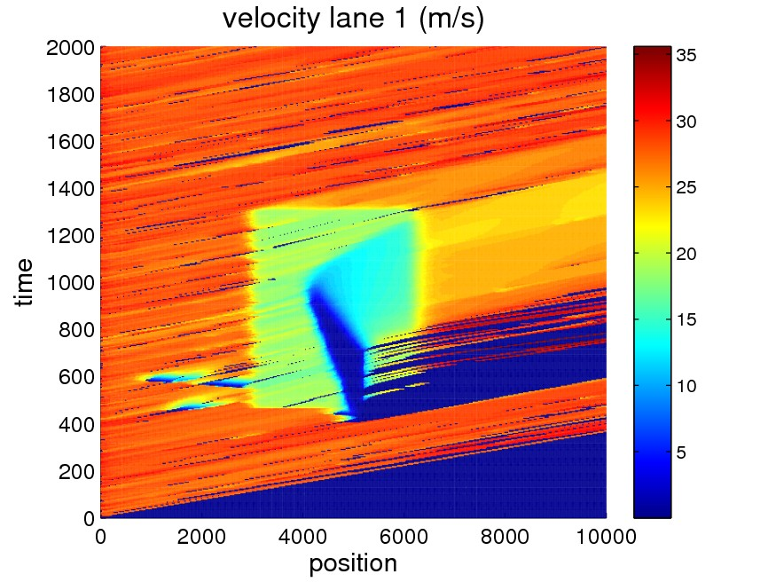
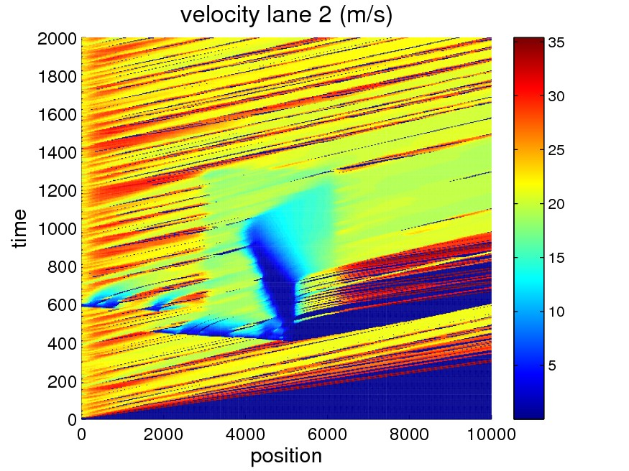
Speed limit reduction: 80 km/h

Slide 41
Summary and Outlook

Slide 42
Summary
Without disturbance
The model isn’t able to produce self-induced traffic jam
High safety distances

Slide 43
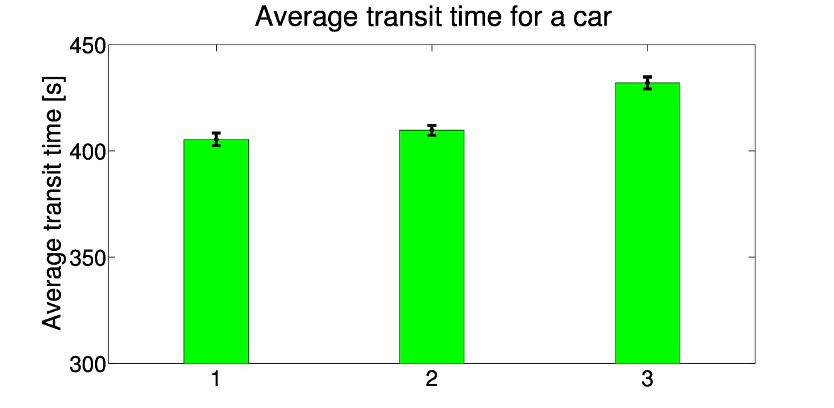
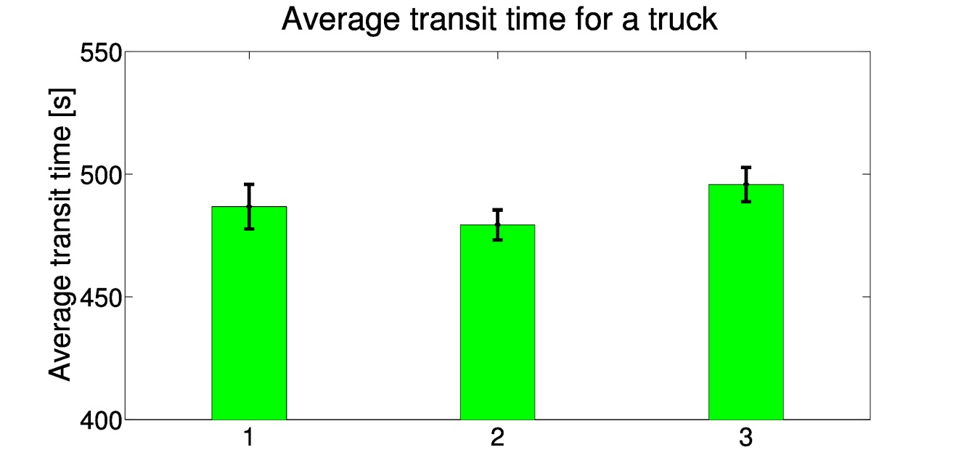
Summary
Disturbance type: sun blinding
1: Without speed limit reduction
2: Speed limit: 100 km/h
3: Speed limit: 80 km/h

Slide 44
Summary
Disturbance type: sun blinding
Also other criteria like smooth traffic flow should be respected
Speed limit reduction to 100 km/h leads to less traffic jam and standstill
Speed limit reduction to 80 km/h relocates just the region with stop-and-go traffic

Slide 45
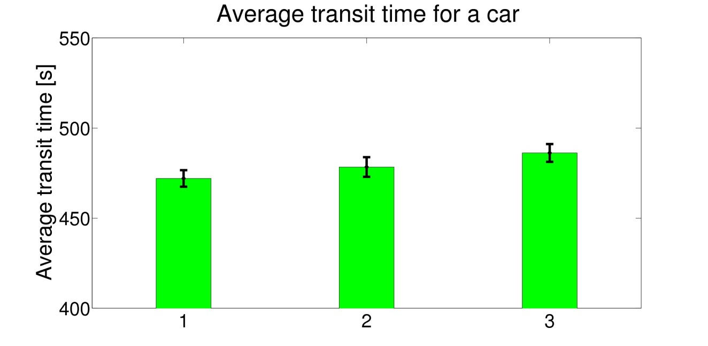
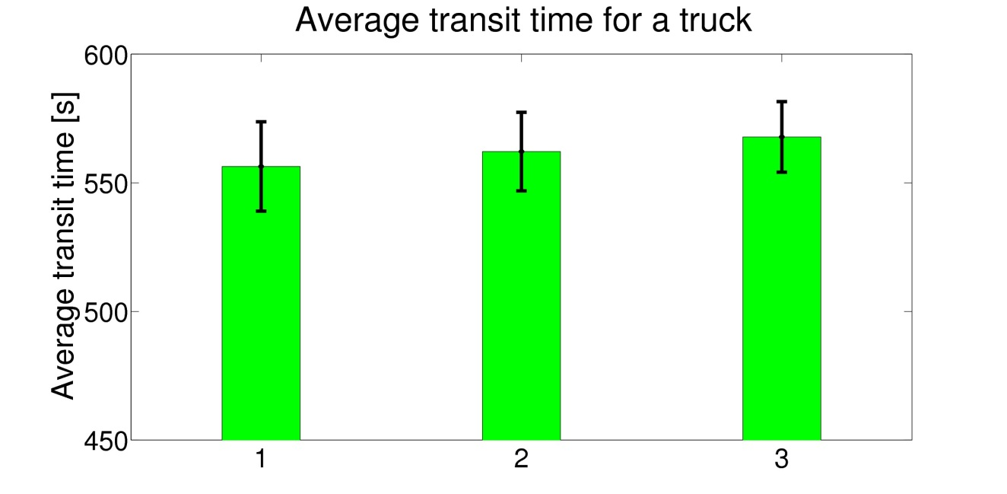
Summary
Disturbance type: accident
1: Without speed limit reduction
2: Speed limit: 100 km/h
3: Speed limit: 80 km/h

Slide 46
Summary
Disturbance type: accident
Standstill is inevitable
Second leg of jam resolves faster with speed limit reduction to 100 km/h

Slide 47
Outlook
Where and when should the limitation start and when should it finish?
Initialize speed limit reduction based on live data
Distribute speed limit reduction over a longer section of highway and several steps

Slide 48
References
[1] M. Treiber and D. Helbing, “Explanation of observed features of self-organization in traffic flow“, arXiv preprint cond-mat/9901239, 1999.
[2] S. Balietti and K. Donnay, “draw_car.m”, Lecture with Computer Exercises: Modeling and Simulating Social Systems with MATLAB, 2012.

